Slide 1
Application of quantum computing to viper Seating chart problem
Maximizing Employee Happiness with Entangled Electrons
Labweek, July 17, 2017
Ben Mesander & Richard Fliam
Senior Director, VIPER Content Origination Group
Director, Engineering Effectiveness

Slide 2
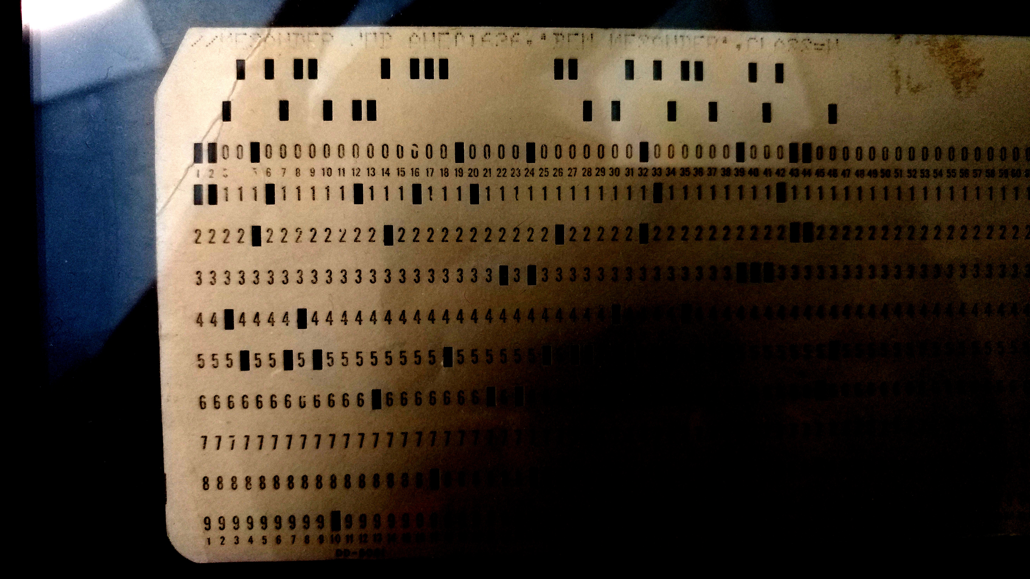
I’ve been doing this a while

Slide 3
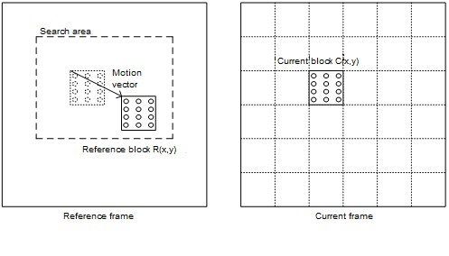
But I still like to learn new things
Programming a Quantum Computer is on my nerd bucket list.
Intrigued by the idea of solving NP-complete problems in reasonable amounts of time.
Several NP-complete problems in video (Example: motion vector estimation for transcode)

Slide 4
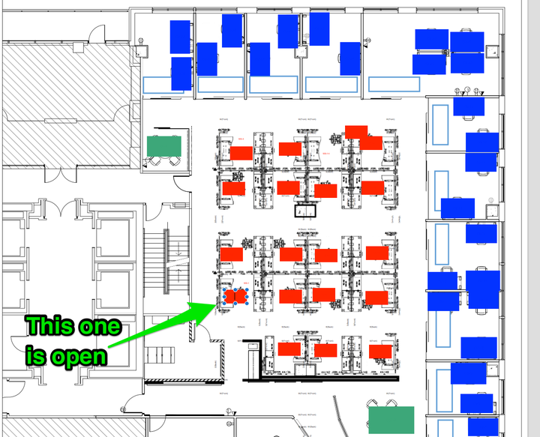
Problem Description
Model of employee happiness:
Light preference (some prefer dark environments, others light)
Noise emission
Noise acceptance
Fixed office space
What arrangement of employees within office space leads to max(employee happiness)

Slide 5

Current seating chart process
Algorithm: Make Coby Figure It Out
Measured time to complete: 9,000,000 hours
Suspect problem is NP-Complete
No obvious better algorithm than exhaustive search / political knife fight
Will not scale linearly as viper grows
Classical computers ill suited for NP-Complete algorithms
Proposal: Use SCIENCE rather than politics to solve the problem

Slide 6
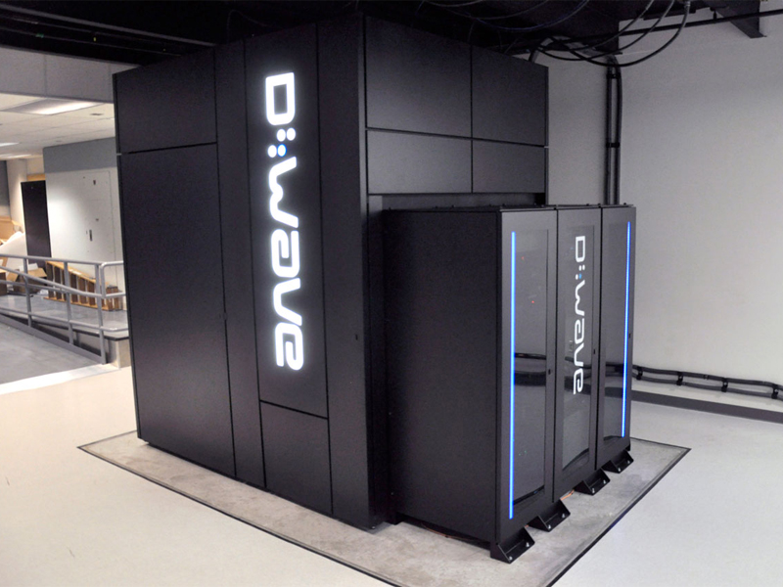
Quantum computer advantages
Efficient at solving certain NP-Complete problems, where:
The only way to solve is to guess answers repeatedly and check them
Number of possible answers to check is same as number of inputs
Every possible answer takes the same amount of time to check
There are no clues about which answers might be better: generating possibilities randomly is just as good as checking them in some special order
Seating chart problem seems to meet criteria
You get to say cool things like Superconducting Josephson Junction
Can’t run Geronimoo

Slide 7
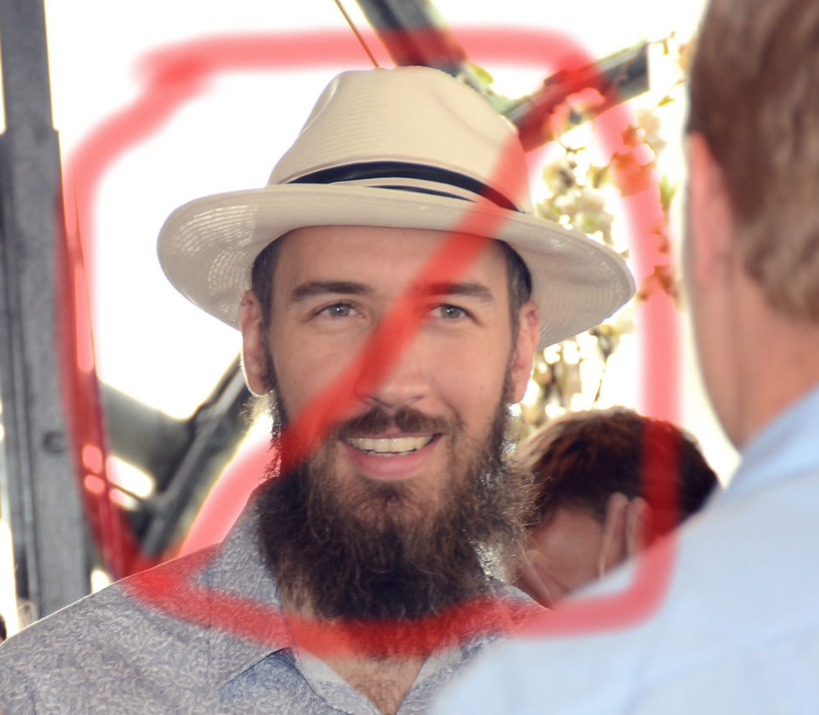
Quantum computer disadvantages
Early days – very primitive / limited environments
Not similar to classical computers – little skill transfer from traditional programming.
Writing a program may involve original research
Not magic – not faster than classical computers at most tasks
Difficult to procure via Comcast procurement process
Superconductors require cooling to ~.015 degrees of absolute zero
Must be shielded from everything (vibration, magnetic fields, electric fields, Arbuckle etc.) in order to prevent quantum decoherence
Can’t run Geronimoo

Slide 8
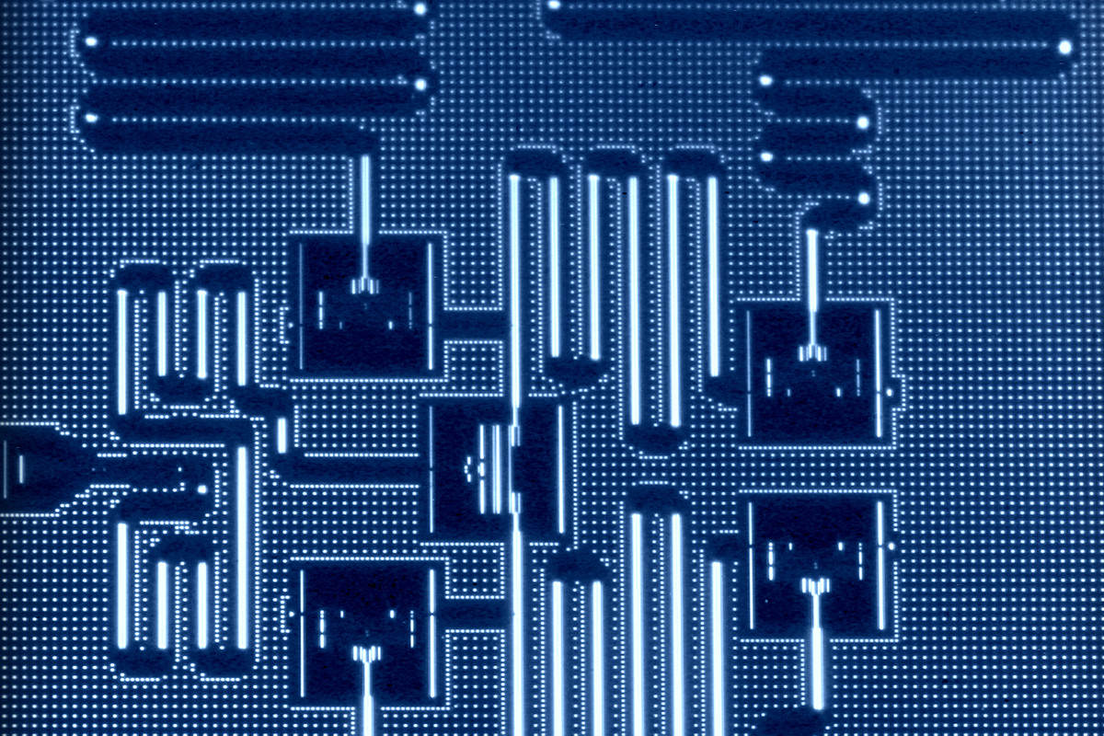
Monday: First attempt: ibm qx2
https://www.youtube.com/watch?v=S52rxZG-zi0 - IBM Researcher Dr. Talia Gershon uses optimizing a wedding seating plan as an example of a problem quantum computers can solve better than classical computers. Seems Legit.
IBM QX2 manual available online
IBM QX2 simulator available online
You can submit batch jobs and run them ON REAL HARDWARE
https://www.research.ibm.com/ibm-q/

Slide 9
IBM QX2 architecture
Different programming model than classical computers
QX2 is a ”Quantum Gate Computer”
No registers
No CPU
5 Qubits of quantum memory, 5 bits of classical memory
Programmed visually via a “score” – also a simple assembly language

Slide 10
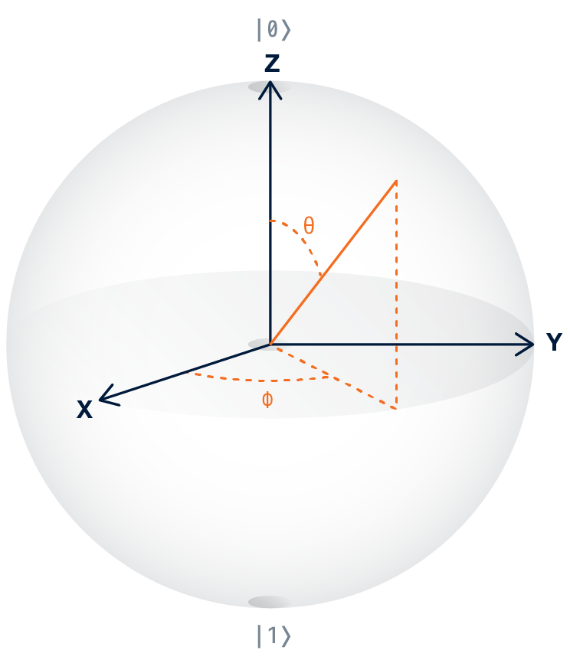
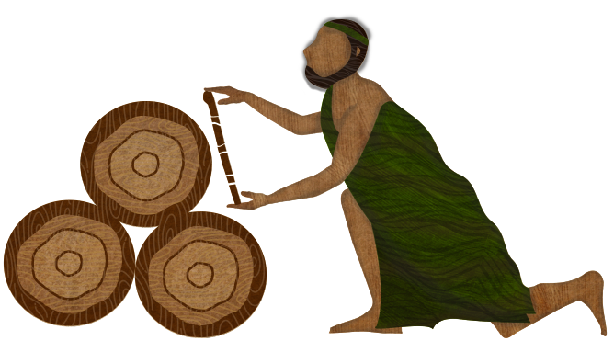
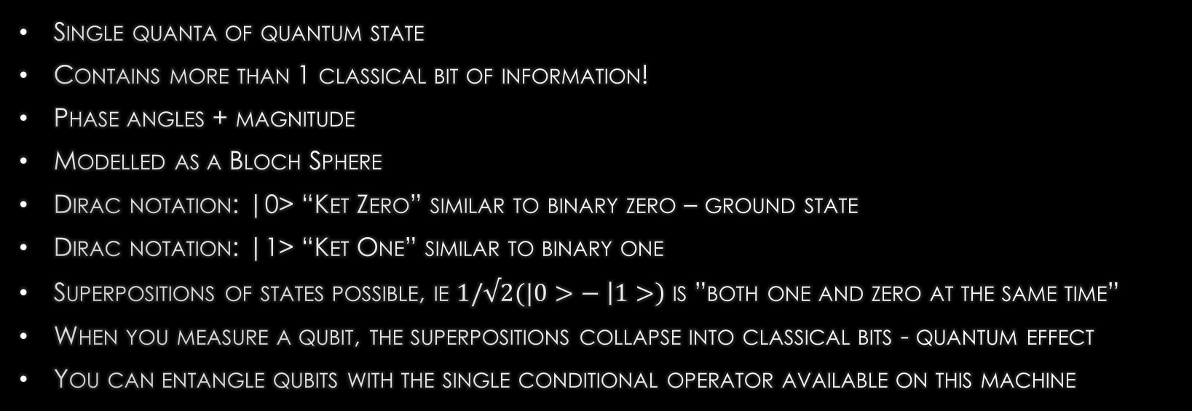
What’s a Qubit?
Single quanta of quantum state
Contains more than 1 classical bit of information!
Phase angles + magnitude
Modelled as a Bloch Sphere
Dirac notation: |0> “Ket Zero” similar to binary zero – ground state
Dirac notation: |1> “Ket One” similar to binary one
Superpositions of states possible, ie $1/√2(|0>− \left|1>\right)$ is ”both one and zero at the same time”
When you measure a qubit, the superpositions collapse into classical bits - quantum effect
You can entangle qubits with the single conditional operator available on this machine

Slide 11
Tuesday: Programming the IBM QX2
Seems to be two general approaches to programming this machine:
Boolean logic circuit where all possibilities are run at once and probabilities of each result are emitted at end of N runs.
Analog-computer type approach where phase angle of qubit is measured via quantum tomography. However, tomography whatsit seems currently unavailable, so first approach is currently only feasible approach.
No looping constructs
Single conditional gate available. All other gates are single-in, single-out, and manipulate phase angle & rotation of qubits.

Slide 12
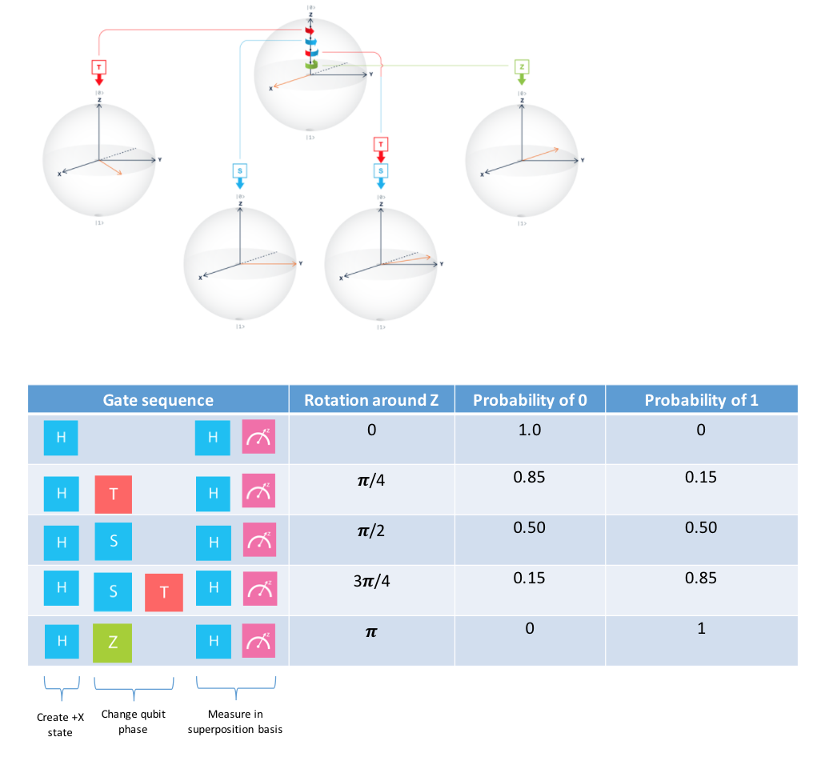
Quantum gates

Slide 13
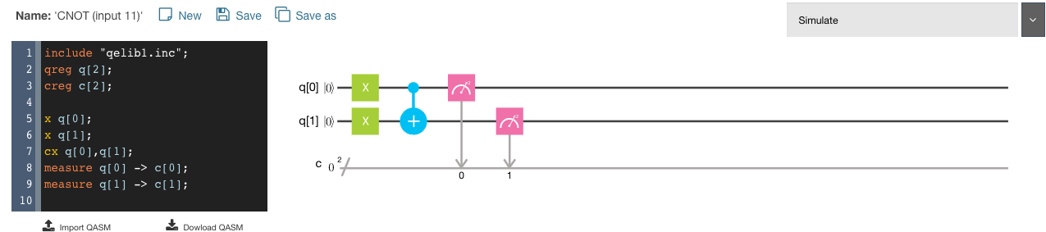
The only conditional
Only conditional is “controlled not”. If top qubit is 1, complement phase of bottom qubit.
Pretty tough sledding here, this is my only conditional and there are no loops. Started to think about theory of computation – can I build a NAND gate? I know if I can, all other things are implementable in terms of NAND.
Spent rest of day trying to build NAND.

Slide 14
ReversIbility
Failed at building NAND gate – always an error one case in truth table no matter what I tried.
Did some reading that evening. Turns out for whatever spooky physics reason, quantum gates must be reversible – that is, putting outputs on the input side must result in the inputs.
NAND lacks this property – that is, if the output was 1, we cannot tell if the input was 00, 01, 10.
2 Input NAND gate
A | B | AB
0 | 0 | 1
0 | 1 | 1
1 | 0 | 1
1 | 1 | 0

Slide 15
Toffoli gate wtf
I had no idea what a reversible gate was, research this, the canonical one is called the “Toffoli Gate” and was discovered while I was an undergrad.
Reversible gates have same # of inputs and outputs and if you present the outputs to the inputs you get the inputs back. Maybe I said that right.
Discovered because it is more thermodynamically efficient – information lost in a NAND gate is dissipated as heat – nowhere else for the information to go.
Input1 | Input2 | Input3 | Output1 | Output2 | Output3
0 | 0 | 0 | 0 | 0 | 0
0 | 0 | 1 | 0 | 0 | 1
0 | 1 | 0 | 0 | 1 | 0
0 | 1 | 1 | 0 | 1 | 1
1 | 0 | 0 | 1 | 0 | 0
1 | 0 | 1 | 1 | 0 | 1
1 | 1 | 0 | 1 | 1 | 1
1 | 1 | 1 | 1 | 1 | 0

Slide 16
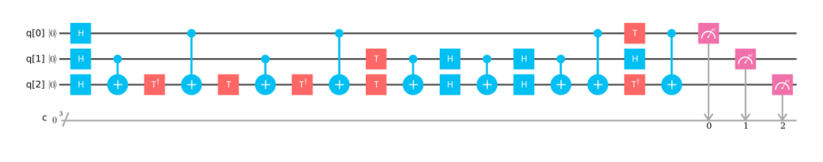
IBM QX2 Toffoli gate
Toffoli gate looks a lot like the controlled not gate, just with one more input.
Sure enough you can build it on a QX2, it’s just a small matter of programming
Below score maps to 31 lines of assembly. For a single conditional.
At this point I begin to suspect that the wedding planning seating problem in the video was merely marketing rather than something I could solve today.

Slide 17
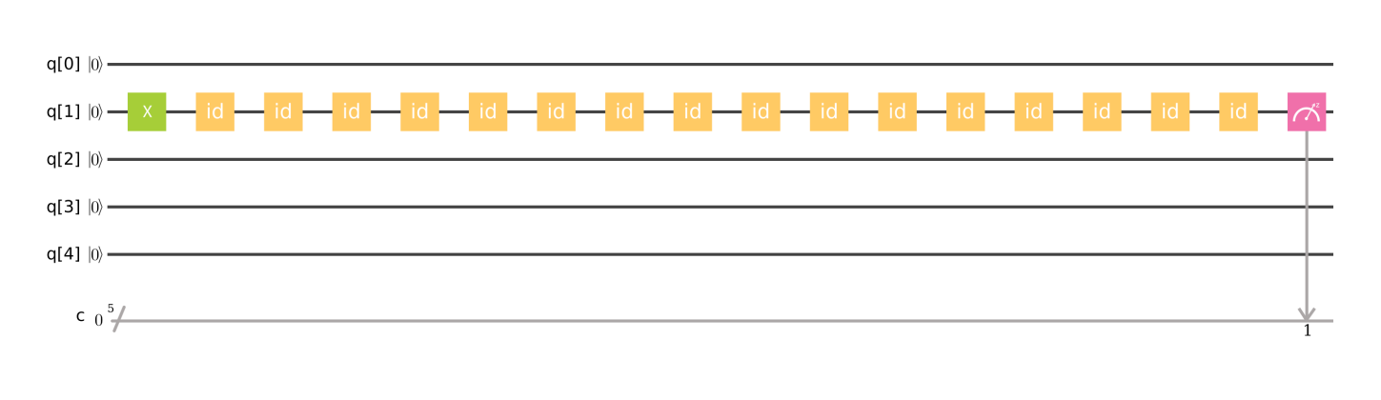
Decoherence
Quantum computers suffer bit errors due to decoherence – the quantum wave equation collapsing.
Example below uses X gate to flip q[1] to |1>. Then 16 idle states before measuring result, which should be |1> 100% of the time.

Slide 18
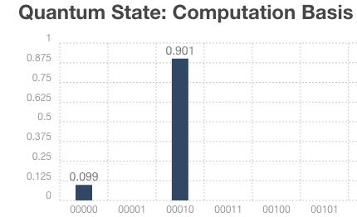
Result on real hardware – 10% error
At this point I decided to give up on the IBM QX2 and switch to a D-WAVE 2000Q tomorrow.

Slide 19
Wednesday: D-WAVE 2000Q
Abdiatic quantum computer – this means it only solves one sort of problem, it is not a “Turing Complete” general purpose computer.
Two thousand qubits! Much more than the 5 that the IBM has.
Qubits can only be measured to be 0 or 1, no access to phase states.
No registers, CPU, etc. Only a sea of qubits and connections between them.
Programming model: load coefficients into memory, and start quantum annealing process.
Simulator available: https://github.com/dwavesystems/qbsolv

Slide 20

Quantum annealing
E(s)=$\sum_{(i,j)∈neigh}{J_{i,j}}s_{i}s_{j}$+$\sum_{i∈V}{h_{i}s_{i}}$
This computer minimizes the above equation. S_{i} is the spin of the I’th electron in a qubit. J and h are arbitrary weights. This is a QUBO (Quadratic Unconstrained Binary Optimization) problem
The first summation is over all the connections between the i’th and j’th qubit, and the second summation is over all the qubits. Each term has a weight.
Sounds complicated, but basically if you can express your problem in this form, the computer will find a global minimum for E(s), which represents your solution.
I feel like this is possible for the seating chart – somehow.
There is a programmer’s guide and a worked out example – 4-color map problem for Canada.

Slide 21
How to program d-wave 2000q?
Download and build simulator
Example program is 4-color map problem for US.
Can’t find any other concrete worked out problems on the internets. Only thing this machine does is color maps?!
Totally unsure how to map office space problem to machine model.
If I could figure out which of the classic NP-complete problem this is, perhaps someone has done the mapping… https://en.wikipedia.org/wiki/List_of_NP-complete_problems
stumped, totally and completely. I need help.

Slide 22
Rubber ducky, you’re the one!
Decide to rubber duck the problem.
However at the last minute I decide to talk to Richard instead, as he will go get coffee with me, and the duck is unresponsive.
Richard wants to talk about a language he’s working on which has a turing-complete type system
Pleasingly evil, possibly more so than C++
Suggests the problem I am having is a Binary Constraint Satisfaction problem.
https://en.wikipedia.org/wiki/Complexity_of_constraint_satisfaction
I find these papers related to solving this problem as a QUBO, including some thoughts on running them on D-Wave hardware:
http://eda.ee.ucla.edu/pub/C166.pdf
http://www.dwavesys.com/sites/default/files/weightedmaxsat_v2.pdf

Slide 23
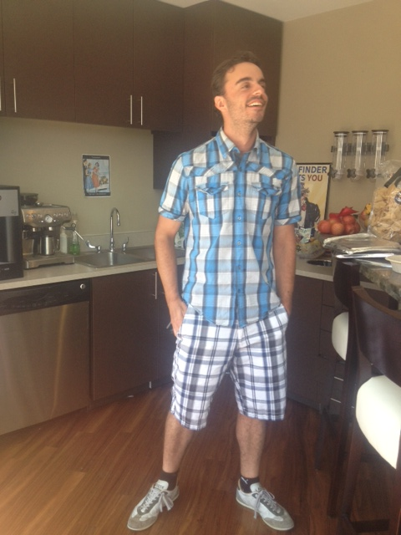
Richard to the Rescue
I could not have done it without you, thank you!
Only one of the papers was comprehensible to me.

Slide 24
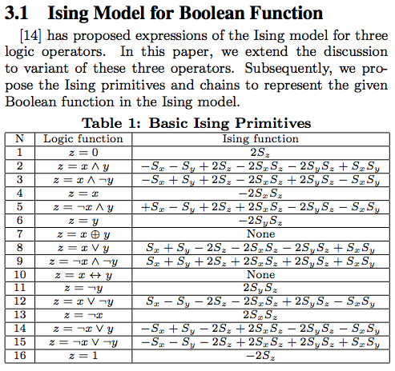
Binary SAT and qubo
Key is a table of logical assertions to node/edge mappings in an ising model.
Ising model consists of an energy function which can be minimized with a quantum annealer.

Slide 25
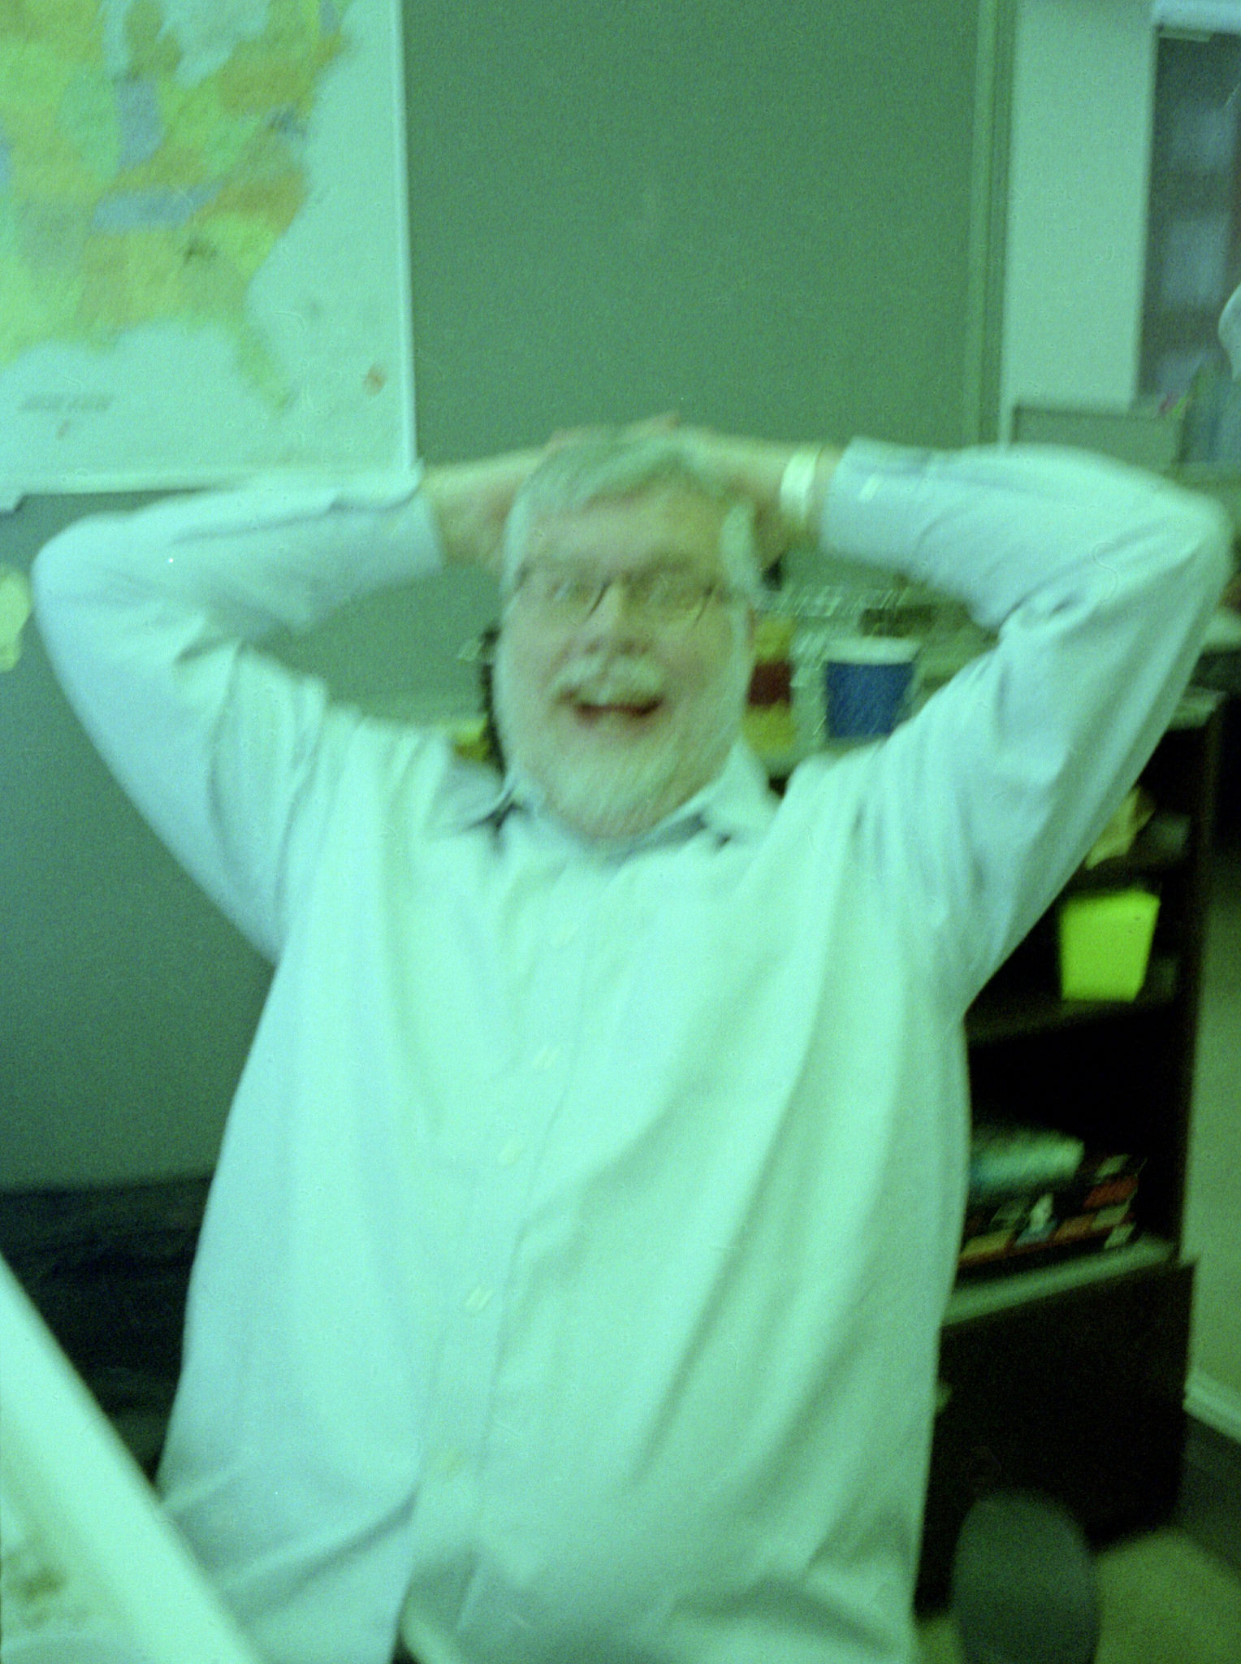

Thursday: composing a Realizable problem
Solve a base case first so algorithm can be verified:
Two offices – one with a window, one without
Two employees – Ben Mesander (prefers light), Jason Burgess (prefers dark)

Slide 26
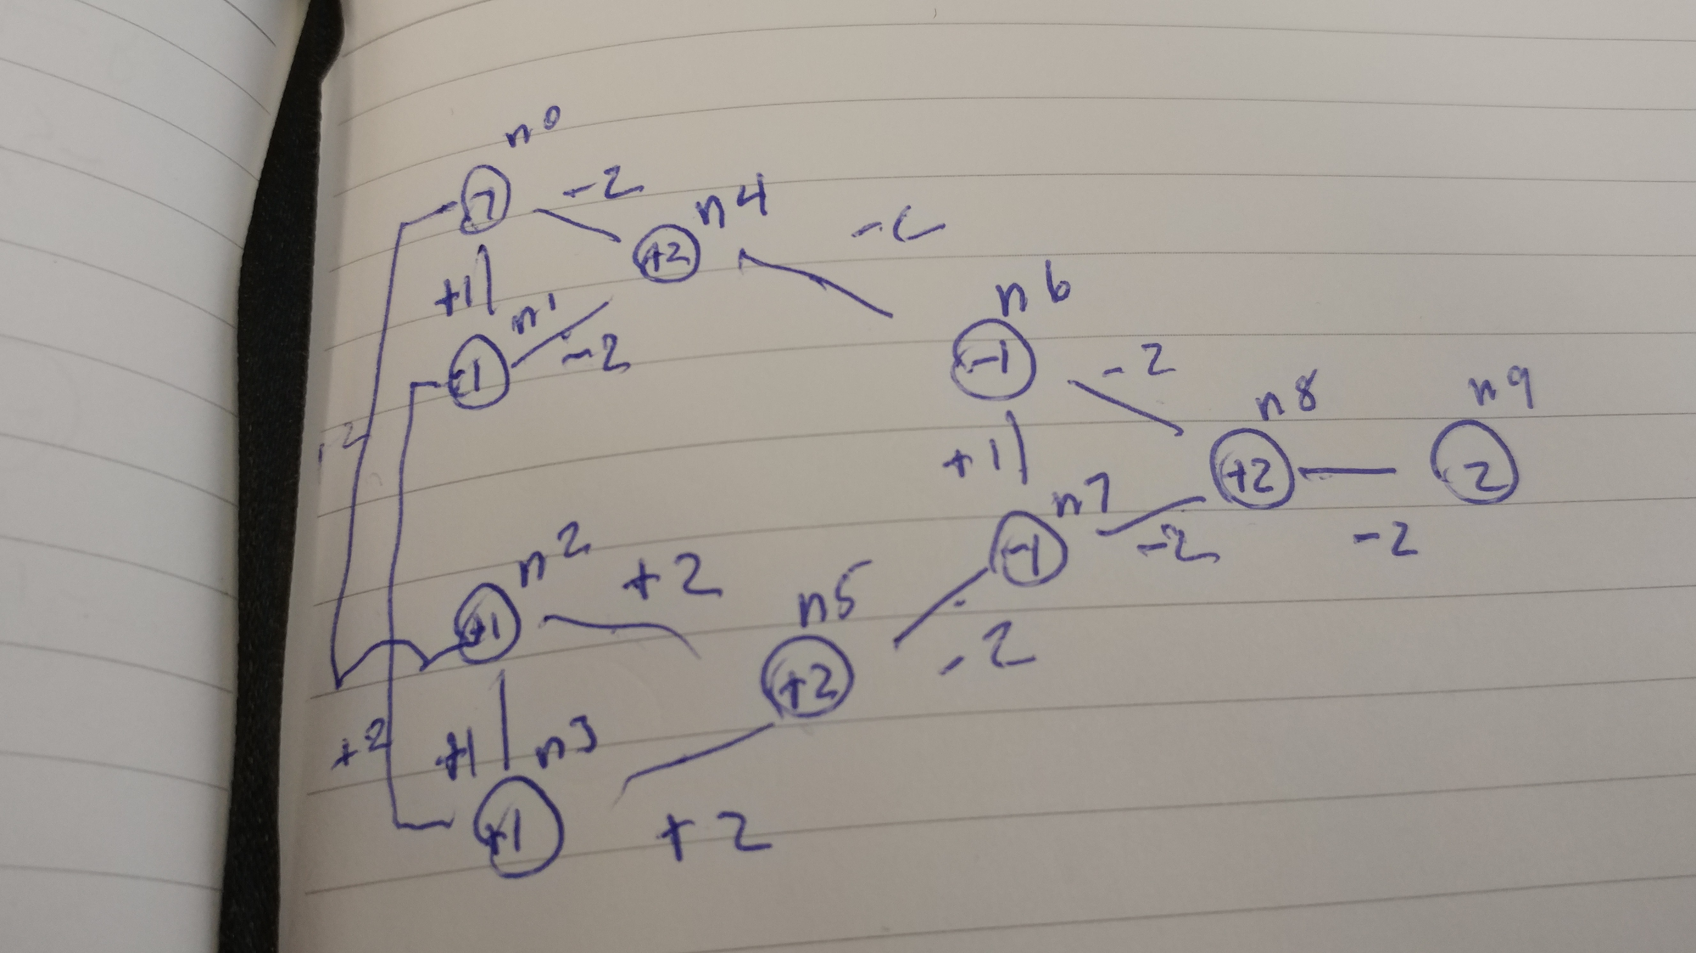
program
Note nodes and vertices – Ising model.
Each one has a weight associated with it.
N0 is Ben, N2 is Jason
Graph contains assertions such as:
Light and dark are opposites
Ben prefers light
Jason prefers dark
There are two offices, one light, one dark
Only one person at a time in an office.
Ben is not Jason (program didn’t work til I added this!)
Quantum annealler will find a solution that satisfies as many of these constraints as possible.

Slide 27
Textual representation of graph in qbsolv emulator format & Solution
c 10 nodes, 14 couplers
p qubo 0 10 10 14
c nodes
0 0 -1
1 1 -1
2 2 +1
3 3 +1
4 4 +2
5 5 +2
6 6 -1
7 7 -1
8 8 +2
9 9 +2
Output:
bash-3.2$ ../../src/qbsolv -i office3.qubo
10 bits, Classical tabu solver, find Min, SubMatrix= 46, -a o, timeout=2592000.0 sec
1100101110
-8.00000 Energy of solution
0 Number of Partitioned calls, 1 output sample
0.00081 seconds of classic cpu time
c couplers
0 1 +1
0 4 -2
0 2 +2
1 3 +2
1 4 -2
2 3 +1
2 5 +2
3 5 +2
4 6 -2
5 7 -2
6 7 +1
6 8 -2
7 8 -2
8 9 -2

Slide 28
1100101110 <- IT WORKED (maybe) !!!!!!!!!!
Leftmost bit (n0) 1=Ben
n1 1=Light office
n2 0=Jason
n3 0=Dark office
Other bits are incidental intermediate qubit values – but it think I have a bug in my program.
This can be extended to more characteristics and offices by increasing the number of qubits per user and characteristic. A preprocessor on a classical computer could read a list of users and preferences and generate an input file.
Programming paradigm is very different than classical computer – it is “how do I express this problem as an energy function” and then calculation of qubit and connector coefficients.

Slide 29
1100101110
I think the last bit should be a 1, not a 0
There is some bug in my program although it got the “right” answer
Not sure if I should make the Ising model have disjoint true statements or try to “and” them all together.
Likely need some formal training in this so I can learn from others, did the best I could in a labweek setting.

Slide 30
Cost model
9,000,000 hours to arrive at seating chart
Assuming Coby makes the same as me, $10/hr
$90,000,000 to generate seating chart currently
Cost of D-WAVE 2000Q: $12,000,000
Cost savings to Comcast: $88,000,000
Makes all employees 10x employees, so viper effectively becomes a 2700 user organization.
All current VIDIQs can be completed in a single year.

